Slide 1
Create Embedded Web Experiences with Tabs for Microsoft Teams

Slide 2
Microsoft Teams extensibility overview
Microsoft Teams tabs
Creating custom tabs for Microsoft Teams

Slide 3
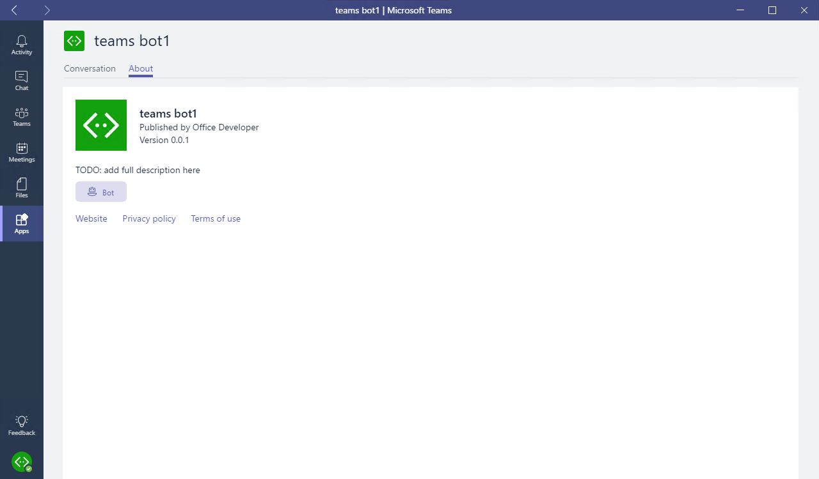
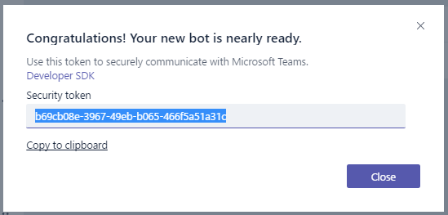
Microsoft Teams-extensibility options
Microsoft Teams App
Tabs
Bots
Messaging extensions
Webhooks & connectors
Webhooks & connectors
Receive & reply to messages
Notes:
Microsoft Teams enables developers to create custom experiences for users. For the best and most extensible option for adding your service into Teams, create a Microsoft Teams app.
A Microsoft Teams app is a package of services that you host, that can be distributed through the Microsoft Teams product or uploaded by owners. These apps can consist of custom tabs, bots, messaging extensions, or webhooks and connectors.
For quick one-off integration of your existing webhook, you can take advantage of our webhooks & connectors feature. This ad-hoc extensibility option allows you to set up webhooks / notifications in a specific team, with no additional coding required.

Slide 4
What is a Teams app?
Package of services available to users in the contexts or “scopes” that make the most sense
Services
Tabs
Bots
Messaging extensions
Webhooks & connectors
Scopes
Personal & App bar
Team & Channel
Group Chat
Package & deployment
Upload one Team
Tenant App Catalog
Office Store
Notes:
Apps in Microsoft Teams allow you to make your service available to users in the contexts - or "scopes" - that make the most sense.
You declare precisely which capabilities you support, in which scopes, via your app package's manifest file. Microsoft Teams app capabilities (such as bots, tabs, and so on) are available in most scopes. These capabilities are offered via a single Microsoft Teams app package that users can acquire through the Microsoft Teams in-product app gallery, the Office Store, or uploaded directly by your organization.

Slide 5
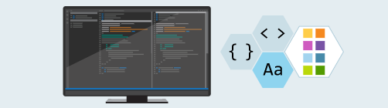
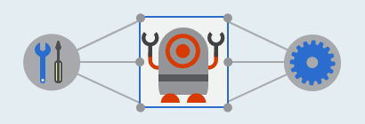

How to create a Microsoft Teams App
Develop components
HTML
TypeScript / JavaScript
.NET
Integrate with Teams
Microsoft Teams JavaScript SDK
Bot Builder SDK - Node.js & C#
Package and deploy
Host web pages and services
Create and package manifest
Upload/publish package
Notes:
How do you create a custom Microsoft Teams app?
You'll first development the components that support your Microsoft Teams app. Microsoft Teams apps are web applications that can be created using HTML, TypeScript, or JavaScript, client-side web frameworks such as React, and/or any server-side framework such as .NET.
Microsoft Teams apps can be stand alone or they can integrate with Microsoft Teams. Microsoft provides a JavaScript SDK for interactive with the Microsoft teams client and a Bot Builder SDK for building bots.
Once you're finished creating the application, the final step is to package and deploy the application. Every Microsoft Teams app contains a manifest file that describes all aspects of your app. The manifest includes the URLs and unique identifiers for the components you've created to implement the application. After creating the manifest, create a package that includes the manifest and associated images used by the app. This package is just a ZIP file. Prior to uploading and publishing the package, you need to deploy all resources that implement the app. These resources include web pages and services used within tabs, bots, and webhooks.

Slide 6
Microsoft Teams Tabs
Notes:
In this module, we are going to focus on creating custom tabs for Microsoft Teams.

Slide 7
What is a Microsoft Teams tab?
Enables developers to display rich interactive web content in Microsoft Teams
Options for creating custom tabs:
Adapt and include existing web-app experiences
Build tab from scratch
Tabs are web applications hosted by the provider
Tabs display web applications within an IFRAME in the Microsoft Teams client
Notes:
A Microsoft Teams tab enables developers to display rich interactive web content within the Microsoft Teams clients. There are two approaches to create a custom tab. You can either take an existing web-app experience and adapt it to a custom tab. You can also build a custom tab from scratch.
Microsoft Teams tabs are simply web applications that are hosted by the provider or developer of the application. A tab in Microsoft Teams displays the specified web app within an \<iframe\> in the Microsoft Teams client.

Slide 8
Tabs differ from web applications when browsing the same content
Tabs display web content in an IFRAME
Can limit to only load in Microsoft Teams
Authentication is different
Cross-domain validation is different
Must list all domains that can be displayed in the tab
Web application style is based on the Teams client light / dark / high-contrast mode
Communication between Teams & the hosted page handled via Teams JavaScript client SDK
Web app must call microsoftTeams.app.initialize() to display page
Notes:
While Microsoft Teams tabs are \<\<iframe\>\> that display web pages, there are some differences between interacting with the web app within the Microsoft Teams client compared to just browsing the same content.
Microsoft Teams tabs always display web content in an \<iframe\> where a web page is loaded in any browser. This allows you to create unique experiences with the web app for only Microsoft Teams by limiting where the application is hosted. For instance, you can limit a web page to only be displayed within an \<iframe\> from a specific domain such as teams.microsoft.com.
Authentication is handled differently in a Microsoft Teams tab compared ot a web app, either via a popup or calling Azure AD to fetch tokens. Most websites simply redirect to a login provider that typically breaks for custom tabs that are hosted inside of an \<iframe\>. Tabs break in this experience because the sign in pages typically do not load within an \<iframe\> to prevent click-jacking.
Cross-domain navigation is handled differently in tabs from a web app. The Teams client needs to validate the origin against a static validDomains list in the app manifest when loading or communicating with the tab.
Microsoft Team tabs can be styled to match the current Microsoft Teams client's theme such as default, dark or high contrast.
Developers of Microsoft Teams tabs can also communicate with the hosting Microsoft Teams client using the JavaScript SDK (microsoftTeams.initialize()). The SDK gives Teams a communication channel with the hosted page and more visibility into its operations.

Slide 9
Tab Scope: Where can a tab reside?
Team
Added to a channel within a team
Shared experience with all team members in the channel
Also referred to as channel tabs previously configurable tabs
Group Chat
Like team scope, but can be used in group chats
Available in conversations between two 2 or more users
Personal
Available only to an individual user
Accessible via the app bar side navigation
Previously referred to as static tabs
App bar
Notes:
Teams determines where a tab can be used based on its scope. Scope is set in the app manifest, and can be one of three (3) values:
The first is the Team scope. Tabs in channels allow teams to interact with your shared experience. These tabs are referred to as channel tabs, previously known as configurable tabs. When these tabs are added to team, a user configures the content of your tab experience when the tab is first added to a channel.
The next option for a tab scope is a group chat. Channel tabs can also be used in group chats. These are conversations between two (2) or more users.
The final option is the personal scope. Personal tabs allow users to interact with your experience privately. The content in a personal tab is only relevant to individual users.

Slide 10
Developing Custom Microsoft Teams Tabs
Notes:
This section will address the process of creating custom tabs for Microsoft Teams.

Slide 11
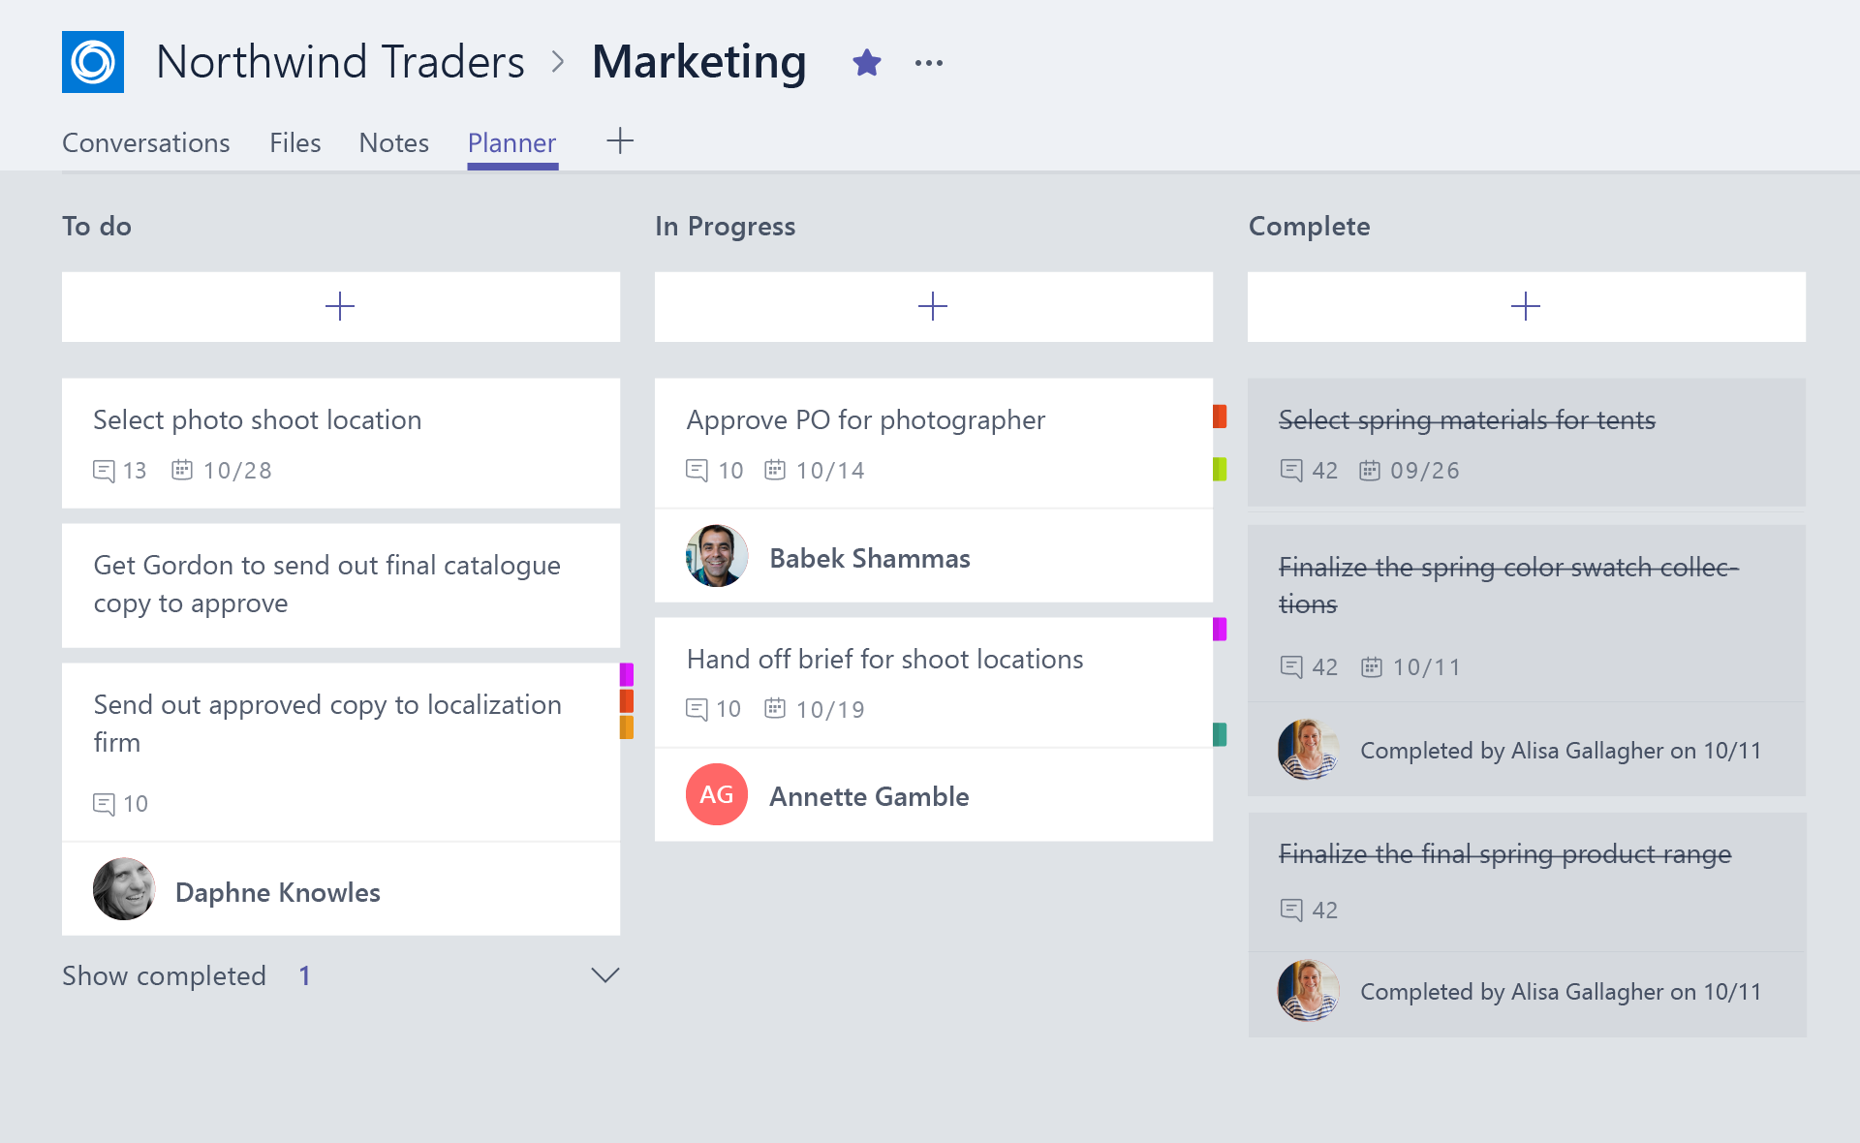
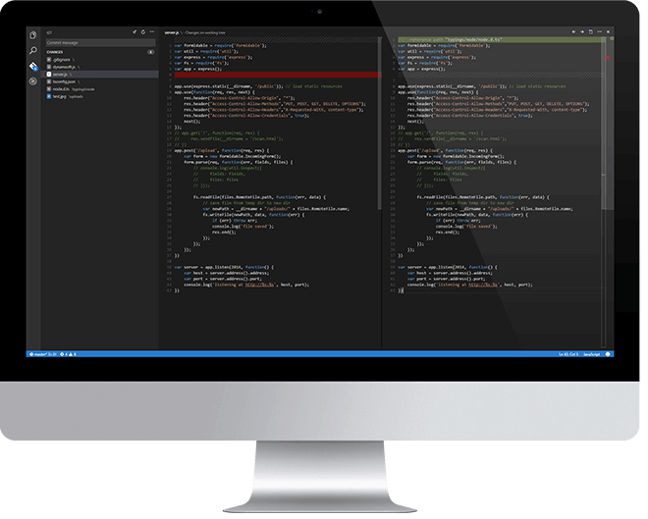
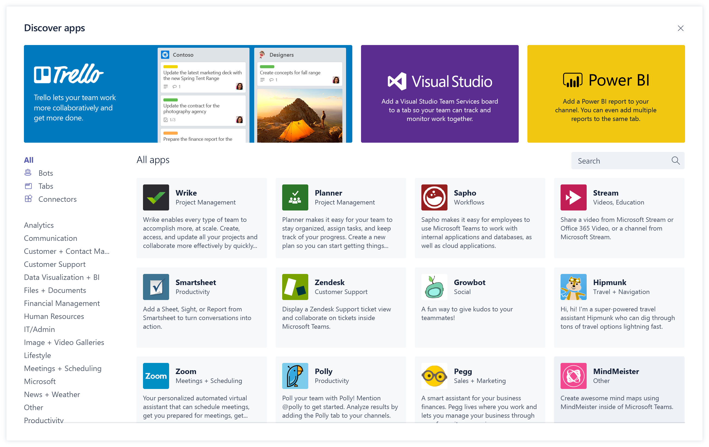
Overview of building a Microsoft Teams Tab
Design a great tab
Select relevant app functionality
Scope and focus the user experience
Integrate and streamline access
Develop your tab
HTML/JavaScript/TypeScript
REST services
Deep Linking and context
Deploy your tab
Upload to Team
Upload to Tenant App Gallery
Submit to Office Store
Notes:
Let’s look at what is involved in building a Microsoft Teams tab.
Microsoft has design guidelines for creating custom tabs that include the following:
Focus on functionality: Tabs work best when they’re built to address a specific need. Focus on a small set of tasks or a subset of data that’s relevant to the channel the tab is in.
Reduced chrome: Avoid creating multiple panels in a tab, adding layers of navigation, or requiring users to scroll both vertically and horizontally in one tab. In other words, try not to have tabs in your tab.
Integration: Find ways to notify users about tab activity. For example, post message card to a conversation about tab activity.
Conversational: Find a way to facilitate conversation around a tab. This ensures that conversations center on the content, data, or process at hand.
Streamlined access: Make sure you're granting access to the right people at the right time. Keeping your sign in process simple will avoid creating barriers to contribution and collaboration.
Once you've designed a great Microsoft Teams tab, the next step is to develop it. Tabs are just web apps hosted in an \<iframe\> within the Microsoft Teams client. Developers are free to use any web technologies and frameworks they are most comfortable with to implement the custom tab experience, such as HTML, JavaScript, TypeScript, web frameworks such as React or Angular, and server-side technologies.
The last step is to deploy the custom tab. Unlike other Microsoft Teams extensibility options such as bots and message extensions, developers can upload custom tabs directly to a team. Microsoft Teams apps can also be uploaded your tenant’s app gallery for other users to install in their teams.

Slide 12
Custom Microsoft Teams Tabs: key points
Ultimately a tab is just a web page hosted by the provider / developer
No data stored within Microsoft Teams
Minimal configuration information stored in Microsoft Teams
Consider implementing custom tab with a modern web framework React, Angular, Vue.js, …
Provides more of an “application” experience and less of a “web page” experience to users
Notes:
When creating a Microsoft Teams tab, there are some key points to keep in mind.
A Microsoft Teams tab is just a web page hosted by the tab provider or developer. No data related to the tab is stored in Microsoft Teams; the developer of the tab is responsible for all aspects of the tab including data storage, configuration settings and authentication. Microsoft Teams saves only minimal configuration details on the tab, such as the URLs where the content and website of the tab, the name and IDs of the tab.
One thing you may want to consider when building your tab is to implement the user experience more like an application and less like a web page. Many web sites implement the traditional page-to-page and postback style of submitting and presenting information. The users of your tabs are interacting with your application from the Microsoft Teams client. This can be from a desktop, mobile or web experience, but all facilitate a rich client experience. Using web frameworks, such as React, Angular, and Vue.js, you can implement a rich client experience without continuously reloading the page.

Slide 13
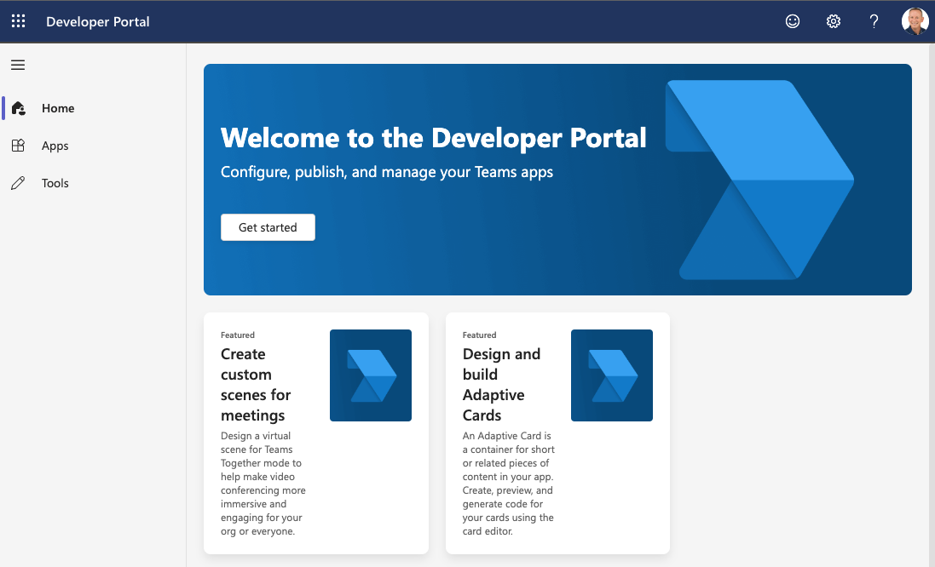
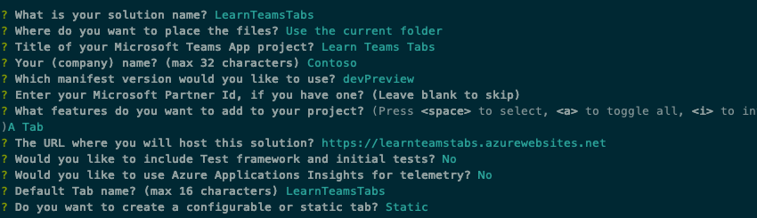
Developer tooling options
Developer Portal
Manifest editor
Preview card rendering
Microsoft Teams Yeoman Generator
& Teams Toolkit for VS Code
Ideal for Node.js based projects
Teams Toolkit for Visual Studio
Ideal for .NET based projects
Notes:
Microsoft provides developers with multiple tools for creating custom Microsoft Teams apps, including custom tabs.
App Studio makes it easy to start creating or integrating your own Microsoft Teams apps, whether you develop custom apps for your enterprise or SaaS applications for teams around the world by streamlining the creation of the manifest and package for your app and providing useful tools like the Card Editor and a React control library. App Studio is a Teams app that can be found in the Teams store. App Studio helps developers preview the rendering of cards and visually edit the manifest file for a Teams app.
Developers have two options for creating the project and resources necessary to implement Microsoft Teams tabs: Node.js or .NET.
Developers who want to create a Node.js based project can use the Microsoft Teams Yeoman Generator. After answering multiple questions related to the project you want to create, the generator will create the scaffolding for your project. This option requires git, Node.js, NPM, and a text editor such as Visual Studio Code.
Developers who want to create a .NET based project can use tooling provided in Visual Studio 2017 or later. Similar to the Node.js option, after selecting the project type and answering multiple questions, Visual Studio will generate the scaffolding for your project. This option only requires git and Visual Studio.

Slide 14
Getting Context within Teams tabs
Obtaining context on current user, team or company useful in many scenarios
Creating / associating resources in the tab with specified user / team
Initiate authentication flow with identity provider easier with login hint
Options for accessing context
URL placeholder values
Use Microsoft Teams JavaScript SDK
Notes:
Your Microsoft Teams tab might require contextual information to display relevant content, or need basic information about the user, team, or company. The tab may need locale and theme information or need to read the entityId or subEntityId that identifies what is in this tab for additional context.
Microsoft Teams offers two ways to obtain context on the current user or from within Microsoft Teams. When loading the content page for a tab, Microsoft Teams can include placeholder values on the URL that the web application can use to obtain context. The web app, once loaded within Microsoft Teams, can use the Microsoft Teams JavaScript SDK.

Slide 15
Accessing context - URL placeholder values
Microsoft Teams replaces placeholders in the content URL when loading web apps as a tab in IFRAMES
Some values set when configuring a tab or generating deep link
https://www.contoso.com/myapp?user={loginHint}&tenant={tid}&theme={theme}
Properties | Description
{entityId} | The id you supplied on the tab’s config page
{subEntityId} | The id you supplied when generating a deep link for specific item within the tab
{loginHint} | Value suitable as login hint for Azure AD
{locale} | Lowercase lang-locale
{theme} | default | dark | contrast
{userPrincipalName} | The user identifier of the current user in the current tenant in email format
{userObjectId} | The Azure AD object ID of the current user in the current tenant
{tid} | GUID id of the current Azure Tenant ID
{groupId} | GUID id of the current Office 365 Group ID
Notes:
Use placeholders in your configuration or content URLs. Microsoft Teams replaces the placeholders with the relevant values when determining the actual configuration or content URL to navigate to. The available placeholders include all fields on the Microsoft Teams Context object available within the JavaScript SDK.
Some of the values available as URL placeholders are set when the tab was configured while others are set when generating a deep link to the tab. Deep links are used to facilitate tab-to-tab communication.
The URL placeholder values include the following: <see slide>

Slide 16
Accessing context - Microsoft Teams JavaScript client SDK
Use the Microsoft Teams JavaScript client SDK to obtain context with Microsoft Teams client
microsoftTeams.app.getContext( function(teamsContext) { … } );
Noteworthy Properties | Description
teamId | The team ID in the format 19:[id]@thread.skype
teamName | Name of the current team
channelId | The channel ID in the format 19:[id]@thread.skype
channelName | Name of the current channel
chatId | The chat ID in the format 19:[id]@thread.skype
locale | Lowercase lang-locale
theme | default | dark | contrast
entityId & subEntityId | The entity (& sub entity) id you set up on your config page
userPrincipalName | The user identifier in email format
tid | GUID identifying the current Tenant ID
groupId | GUID identifying the current Office 365 Group ID
tenantSKU | SKU of the current tenant (for example: EDU)
Notes:
You can also retrieve the information listed above using the Microsoft Teams JavaScript client SDK by calling `microsoftTeams.getContext(function(teamsContext) { … })`.
The context values include the following: <see slide>

Slide 17
Personal Tabs – Manifest
"staticTabs": [ { "entityId": "candidatesTab", "name": "Candidates", "contentUrl": "https://.../Tabs/file.html", "websiteUrl": "https://.../Tabs/file.html?p=1", "scopes": [ "personal" ] } ],
"validDomains": [ "token.botframework.com" ]
staticTabs
contentUrl is hosted in IFRAME in Teams
websiteUrl is used when the user selects “Open in browser”
validDomains
valid domains from which the extension expects to load any content

Slide 18
DEMO
Create a custom Microsoft Teams personal tab

Slide 19
Comparing personal & channel tabs
Channel tab capabilities
Configuration page
Removal page

Slide 20
Comparing personal & channel tabs
Personal tabs
Channel tabs
Previously referred to as static tabs
Scope = personal
Support individual user
Not intended to be shared with others in a team
Displays a web page set in the manifest
Previously referred to as configurable tabs
Added to a channel
Scope = team
Added as part of a chat between two or more users
Scope = groupchat
Supports all members of a team / channel
Displays a web page (content page) set in the configuration page

Slide 21
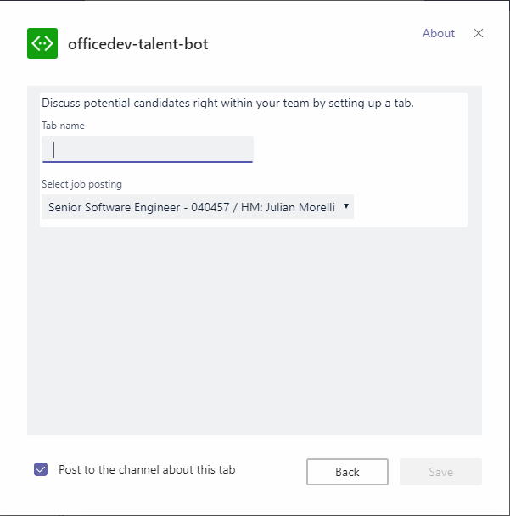
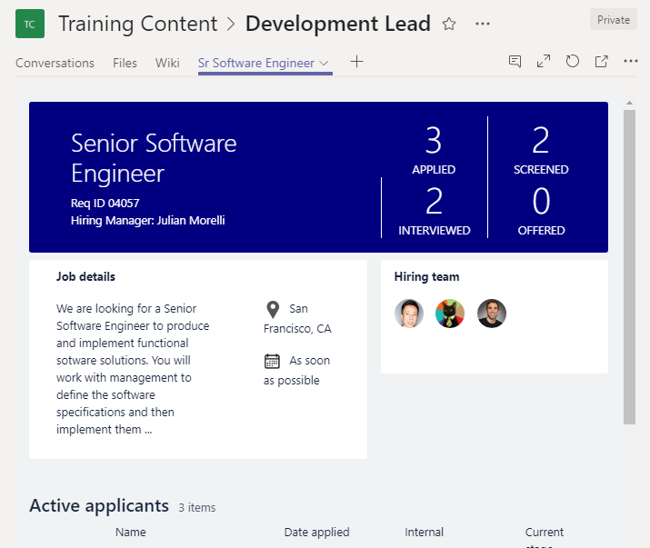
Tab Configuration and Content
Tab Configuration
Configured in manifest
Displayed when Tab added to Channel
Displays a web page specified in the app manifest
Collect information
Call setSettings() specifying ContentUrl and Entity Id
Tab Content
Rendered in IFRAME
Content URL specified by configuration page or manifest
Inspect context for EntityId/SubEntityId
Retrieve state based on Entity/SubEntity/User
Notes:
One characteristic of a channel tab that differs from a personal tab is that channel tabs have a configuration experience displayed to the user when the tab is added to a channel. The configuration page defined in the manifest enables the developer to collect any configuration information the web app may need to customize the information show in the tab.
For example, consider a channel tab that displays the contents of a SharePoint list. The configuration page can collect the SharePoint site and list from the user and use that information to retrieve and display the correct list data in the tab.
The configuration page is another web app that the developer must create. The Microsoft Teams SDK allows developers to attach to an event fired when the user saves the configuration information. You're responsible for saving any configuration information your tab will need.
Developers can set the tab’s `contentUrl` and `entityId` from this save method, based on the options specified in the configuration page.
Similar to a personal tab, the content displayed in a channel tab is displayed in an \<iframe\>. The URL loaded in the \<iframe\> is defined by the `contentUrl` specified in the configuration page. The web app can then use the Microsoft Teams JavaScript SDK to obtain the `entityId` and/or `subEntityId` to determine the content to display. These properties can be used to implement tab-to-tab communication using deep linking.

Slide 22
Channel tab manifest syntax
{
"configurableTabs": [
{
"configurationUrl": "https://{{HOSTNAME}}/configMathTab/config.html",
"canUpdateConfiguration": true,
"scopes": ["team"],
"sharePointPreviewImage": "https://{{HOSTNAME}}/configMathTab-preview.png",
"supportedSharePointHosts": ["sharePointFullPage", "sharePointWebPart" ]
}
]
...
}
Notes:
Channel tabs are defined within the Microsoft Teams app manifest file’s `configurableTabs` collection.
The `configurationUrl` is the https:// URL to use when configuring the tab. This property is required.
The `canUpdateConfiguration` property is the value indicating whether an instance of the tab's configuration can be updated by the user after creation. Default: true.
The scopes property is an array of the scopes the tab supports. Channel tabs can be either **team** and/or **groupchat** for scopes. This property is required.
The `sharePointPreviewImage` and `supportedSharePointHosts` properties are option and used to make the tab available as a web part or full app page within SharePoint sites.

Slide 23
Channel tab capabilities: configuration page
Displayed after adding a tab to a channel
Enables user to configure tab before added to a team
Enable / disable ability to change settings after tab is added to a channel
Example uses:
Specify mapping provider
Select how data should be rendered, such as a list or grid
Set the contentURL and websiteURL of a tab
Notes:
The configuration page is a web page that you host. When a user chooses to add or update a channel tab, Microsoft Teams will load the `configurationUrl` specified in the app manifest within an \<iframe\> inside the Add Tab dialog.
In this page, you present options and gather information from the user about what they want in your tab. For example, you may let the user select existing app resources (such as files or task lists) or create new resources just for this tab.
You may decide a tab’s configuration can or cannot be changed once it has been added to a team. This can be controlled within the app manifest using the `canUpdateConfiguration` flag. By default, this property is set to true.

Slide 24
Channel tab capabilities: configuration page
Notes:
This is an example of the channel tab configuration page experience.
The image is the configuration page that prompts the user which mapping site to use in the custom tab.
The image on the right shows the tab context menu. If the channel tab doesn't have the `canUpdateConfiguration` property set to false, the Settings option is displayed in the menu. Selecting this menu option will display the configuration page again.

Slide 25
Configuration page - implementation & requirements
Like a tab, just a web app loaded within an IFRAME
Implement the user interface
Notify Microsoft Teams once settings configured
Consider: where & how will app save its settings?
Requirements:
Must load within an IFRAME
Include Microsoft Teams JavaScript SDK & handle the registerOnSaveHandler() event, notifying Microsoft Teams of success
Notes:
Configuration pages, just like personal and channel tabs, are just web pages loaded within an \<iframe\>. The developer is responsible for implementing the user interface. Similar to the content pages for tabs, the web page used as a configuration page must be permitted to load within an \<iframe\>.
One requirement for configuration pages is they must notify Microsoft Teams when the settings have been configured and saved. This is done by registering a save handler using the `registerOnSaveHandler()` event. Within your handler for this event, use the `microsoftTeams.settings.setSettings()` method to update the tab’s settings and the `saveEvent.notifySuccess()` method to make Microsoft Teams aware the settings were successfully saved.
Microsoft Teams tab developers are responsible for saving any configuration information your tab will need.

Slide 26
Saving settings on configuration page
pages.config.registerOnSaveHandler(
(saveEvent: microsoftTeams.settings.SaveEvent) => {
const host = "https://" + window.location.host;
pages.config.setConfig({
entityId: this.state.value,
contentUrl: host + "/myTab/?data=",
removeUrl: host + "/myTab/remove.html",
suggestedDisplayName: "My Tab"
});
saveEvent.notifySuccess();
}
);
Notes:
This code is what you will use to save any settings from the configuration page in your web app as well as notify Microsoft Teams the settings were saved successfully.
Register your handler when the save button is clicked in the configuration page by calling the `microsoftTeams.settings.registerOnSaveHandler()` method from the Microsoft Teams JavaScript SDK.
Use the `microsoftTeams.settings.setSettings()` method to save any settings on the channel tab. Finally, notify Microsoft Teams the configuration page completed successfully by calling the `saveEvent.notifySuccess()` method.

Slide 27
Channel tab capabilities: removal page
Displayed when a tab is removed from a channel
Optional & not required
Useful when a tab provisioned resources that should be cleaned up when no longer in use
Notes:
Channel tabs can be configured with a removal page. This page is displayed when a channel tab is removed from a channel or group chat. Developers can use this page to clean up any resources that may have been created when adding the tab to the channel.

Slide 28
DEMO
Create a custom Microsoft Teams channel or group tab

Slide 29
Authentication & Microsoft Teams Tabs
OAuth 2.0 implicit grant flow
Interactive authentication via popup
Silent authentication & SSO

Slide 30
Authentication & Microsoft Teams tabs
Tabs, and the underlying web app, implement authentication if the app requires it
Tabs can use OAuth 2.0 implicit grant flow
Microsoft Teams provides context hints, but should only be used as hints & not proof of identity
Auth flow should be triggered by user action
DO NOT open popups automatically for authentication – likely to trigger browser popup blockers & confuse the user
DO add a button in the configuration / content page that initiates the authentication process
Notes:
Custom applications that you build as custom tabs for Microsoft Teams may need to access protected resources. Many of these resources, such as secured HTTP APIs, require that users authenticate and provide an OAuth 2.0 access token when submitting their request.
Microsoft Teams has built in support for enabling these applications, but the entire authentication process and flow is the responsibility of the developer to implement in the web applications used to implement the custom tabs.
OAuth 2.0 is an open standard for authentication and authorization used by Azure AD and many other identity providers. Microsoft Teams tabs can use OAuth 2.0 implicit grant flow to enable users to authenticate and access these protected resources.
One thing to keep in mind when building custom tabs that require the user to be authenticated: don't assume the current user in Teams is the authenticated user. The Microsoft Teams context can provide information about the current user, such as context hints like the current user’s ID, but your tab shouldn't treat it as a proof of identity.
Recall that a custom tab is just an \<iframe\> displaying the contents of a web application. Your web app can use placeholder values added to the URL by Microsoft Teams such as the current user’s profile name (also known as the `userProfileName` or UPN). A malicious user could send someone a URL that loads your web app with someone elses profile in the URL with the goal of obtaining someone elses information.
Therefore, you should never treat this information as proof of identity of the current user. Instead, use it as the login hint when prompting the user to sign in.
Many identity providers, including Azure AD, don't allow their login experiences to be hosted in an \<iframe\>. Because all tabs in Microsoft Teams are \<\<iframe\>\>, you will implement a popup window pattern to initiate the authentication process. This popup should only be initiated by a user action; it should not open automatically. Popups that open automatically are likely to trigger the browser’s popup blocker and confuse the user experience. Create a button within the tab’s configuration or content page that initiates the authentication process.

Slide 31
OAuth 2.0 Implicit Grant Flow & Microsoft Teams tabs
Notes:
A basic understanding of the OAuth 2.0 implicit grant flow is a prerequisite for working with authentication in Microsoft Teams tabs. The UML sequence diagram here documents the process
The user interacts with the content on the tab configuration or content page, commonly implemented using a button that will initiate the sign-in process.
The tab builds the URL for its authentication start page, optionally using information from URL placeholders or by calling `microsoftTeams.getContext()`. This Microsoft Teams JavaScript SDK method streamlines the authentication experience for the user. For example, when authenticating with Azure AD, if the `loginHint` parameter is set to the user's email address, the user may not even have to sign in if they have done so recently. The may not have to sign in because Azure AD will use the user's cached credentials if possible. In this scenario, the popup will flash briefly and then disappear.
The tab then calls the `microsoftTeams.authentication.authenticate()` method and registers the `successCallback` and `failureCallback` functions.
Microsoft Teams opens the start page in an \<iframe\> in a pop-up window. The start page generates random state data, saves it for future validation, and redirects to the identity provider's authorize endpoint (such as **https://login.microsoftonline.com/{tenant ID}/oauth2/authorize** for Azure AD).
Like other application auth flows in Microsoft Teams, the start page must be on a domain that's in its `validDomains` list, and on the same domain as the post-login redirect page.
IMPORTANT: The OAuth 2.0 implicit grant flow calls for a state parameter in the authentication request which contains unique session data to prevent a cross-site request forgery attack. The examples below use a randomly-generated GUID for the state data.
The user, on the identity provider's site, signs in and grants access for the required permissions defined in the application’s configuration to the custom tab.
The identity provider redirects the user to the tab's OAuth 2.0 redirect page with an access token.
The tab checks that the returned state value matches what was saved earlier, and calls `microsoftTeams.authentication.notifySuccess()`, which in turn calls the `successCallback` function registered in the initial setup of this flow.
Microsoft Teams closes the pop-up window.
The tab either displays configuration UI or refreshes or reloads the tabs content, depending on where the user started from.

Slide 32
Authentication popup page flow
Tells Microsoft Teams starting the authentication process microsoftTeams.authentication.authenticate({options})
Opens a popup that redirects to your identity provider & specifies the redirect URL
Page specified in redirect URL inspects response for authentication success / failure
Notify Microsoft Teams of a successful or failed authentication
Predefined authentication failure reasons:
CancelledByUser: popup closed before completing the authentication flow
FailedToOpenWindow: popup couldn’t be opened
Notes:
Before implementing authentication in your Microsoft Teams tab, you must first configure your identity provider. In a scenario where Azure AD is the selected identity provider, you need to register a new Azure AD application and define the permissions, that the application needs. The user will be required to consent these permissions to the application when they first sign in to the application.
The Microsoft Teams JavaScript SDK contains an API to initiate the popup authentication process. The `microsoftTeams.authentication.authenticate()` method takes a single configuration object in as a parameter. This configuration object enables you to specify the URL of the page that initiates the authentication flow as well as the success and failure callback handlers when the process completes.
If the authentication process failed, that Microsoft Teams will report back two with the error. This includes two predefined predefined failure reasons specific to Microsoft Teams:
- The **CancelledByUser** reason indicates the user closed the popup before completing the authentication flow.
- The **FailedToOpenWindow** reason indicates Microsoft Teams was unable to open the popup window. When running Microsoft Teams in a browser, this error indicates that the window was blocked by the browser’s popup blocker. You are also free to provide your own authentication failure reasons.
If the authentication process succeeded, you can refresh or reload the page to show content relevant to the newly authenticated user or display the error reason.

Slide 33
Authentication popup page requirements
Primary goal of page: redirect user to your configured identity provider for user to sign in
Redirection can also be done via:
Server-side: HTTP 302
Client-side: window.location.assign(authEndpoint)
Consider using the tab’s context to provide a login hint to the identity provider
msTeamsContext.userPrincipalName
Consider including the state property option
Ensure malicious user is not involved in the authentication flow
Used to prevent CSRF attacks
Notes:
Let’s look at this authentication popup page a bit more. The primary goal of this popup page is to redirect the user to the configured identity provider to sign in. The popup is enabling you to avoid the limitation that many identity providers do not allow their sign-in forms to be loaded within an \<iframe\>.
This popup page can be handled in one of two ways. You can implement a server-side sign-in process by redirecting the user to the identity provider’s sign-in page using the HTTP 302 redirect response or you can use a client-side option. To implement the client-side option, use `the window.location.assign()` method to change the url of the current page to the identity provider’s sign-in page.
If your identity provider allows you to specify a login hint, such as Azure AD, you can provide that in the sign-in process by retrieving the user’s principal name from the current Microsoft Teams context.
The OAuth 2.0 implicit grant flow calls for a **state** parameter in the authentication request. This contains a string unique to the session you can use to prevent a cross-site request forgery (CSRF) attack. The state can be a random string that you'll check when receiving the authentication response from the identity provider. The recommended practice is to only accept the response from the identity provider if the provided state property contents match the value you submitted in the initial request. If the two state values to not match, you may be the target of a CSRF attack.

Slide 34
Authentication flow example: trigger popup from user action
private async getAccessToken(promptConsent: boolean = false): Promise<string> {
return new Promise<string>((resolve, reject) => {
microsoftTeams.authentication.authenticate({
url: window.location.origin + "/auth-start.html",
width: 600, height: 535,
successCallback: (accessToken: string) => {
resolve(accessToken);
},
failureCallback: (reason) => {
reject(reason);
}
});
});
}
Notes:
Now that we've covered the authentication process, let’s look at the relevant code for each of the parts involved in the popup window pattern.
The code on this page is triggered by the user action, such as clicking on a button within the configuration tab or content page for a tab. It uses the Microsoft Teams JavaScript SDK to call the authenticate() method. This method sets the size of the popup window, the success, and failure callbacks and the initial URL for the popup page.

Slide 35
Authentication flow example: auth-start.html
let config = {
clientId: "<<AzureAD AppID/ClientID",
redirectUri: window.location.origin + "/auth-end.html",
cacheLocation: "localStorage"
};
// override URL to AzureAD auth endpoint to include extra query params
config.displayCall = function (urlNavigate) {
if (urlNavigate) {
urlNavigate += "?scope=open+profile";
window.location.replace(urlNavigate);
}
}
let authContext = new AuthenticationContext(config);
authContext.login();
Notes:
The authentication start page loaded within the popup has one job: to redirect the user to the chosen identity provider’s sign-in page.
This code uses the Azure Active Directory Authentication Library JavaScript (ADAL.js) to handle the process. You must specify the ID of the application as the `clientID` and the URL of the page Azure AD should redirect the user to after going through the sign-in process.
Notice the code that overrides the `displayCall()` method. This method is giving you a chance to change the URL the user is redirected to when the `login()` method is called. In this case, we are including the scope parameter on the request to ensure Azure AD includes an ID token that contains information about the newly authenticated user.
Finally, the `login()` method is called to start the authentication process. The `login()` method will redirect the user to the Azure AD authorization endpoint.

Slide 36
Authentication flow example: auth-end.html
// <omitted>configure ADAL.js & obtain AuthenticationContext</omitted>
if (authContext.isCallback(window.location.hash)) {
authContext.handleWindowCallback(window.location.hash);
if (window.opener) {
if (authContext.getCachedUser()) {
authContext.acquireToken("https://graph.microsoft.com", function (error, token) {
if (token) { microsoftTeams.authentication.notifySuccess(token); } else if (error) { microsoftTeams.microsoftTeams.notifyFailure(error); }
else { microsoftTeams.authentication.notifyFailure("UnexpectedFailure"); }
});
} else { microsoftTeams.authentication.notifyFailure(authContext.getLoginError()); }
}
}
Notes:
When the user has completed the authentication process with Azure AD, regardless if they were successful or failed the authentication process, they are redirected back to the specified redirect URL.
This code uses the ADAL.js library to check if the user successfully signed in by trying to retrieve the current user by calling the `authContext.getCachedUser()` method. If so, it then requests an OAuth 2.0 access token from the Azure AD for the specified resource. In this case, the code is requesting an access token for the Microsoft Graph.
If a token is received, notify Microsoft Teams of a successful authentication flow and return the access token by calling the `notifySuccess()` method. If a token was not received, notify the tab by calling `notifyFailure()` with the specified error.
Calling either of these methods will trigger Microsoft Teams to close the popup window and execute your previously defined callback functions.

Slide 37
Silent Authentication & SSO
Silent authentication in Azure AD is a simplified form of single sign-on (SSO)
Goal: minimize number of times a user needs to enter login credentials
Use ADAL.js to keep authentication client-side & obtain access token silently
ADAL.js uses a hidden IFRAME to implement the OAuth2 implicit grant flow
Specifies no never prompt user (using prompt=none)
If user interaction required, Azure AD returns an error that can be handled via ADAL.js
In these scenarios, your app would initiate an interactive login
Notes:
Silent authentication in Azure Active Directory (Azure AD) is a simplified form of single sign-on (SSO). Its purpose is to minimize the number of times a user needs to enter login credentials while using your app.
If you want to keep your code client-side, you can use ADAL.js to attempt to acquire an Azure AD access token silently. This means that the user may never see a popup dialog if they have signed in recently.
The ADAL.js library creates a hidden \<iframe\> for OAuth 2.0 implicit grant flow, but it specifies prompt=none so that Azure AD never shows the login page. If user interaction is required because the user needs to sign in or grant access to the application, Azure AD will immediately return an error that ADAL.js then reports to your app. At this point, your app can show a login button if needed.
If silent authentication fails, Azure AD returns an error that can be handled via ADAL.js and your application. In this scenario, your custom tab would fall back to an interactive login using the popup window pattern.

Slide 38
DEMO
Implement authentication in a custom tab

